Slide 1
Clinical Natural Language Technology
An Overview

Slide 2

Definition
Clinical natural language technology (NLT) is the application of natural language processing (NLP), optical character recognition (OCR), computer vision, as well as language and multimodal models in the health care domain.
This report explores the historical context, current trends, and potential future directions for NLT in health care as well as specific future applications.

Slide 3
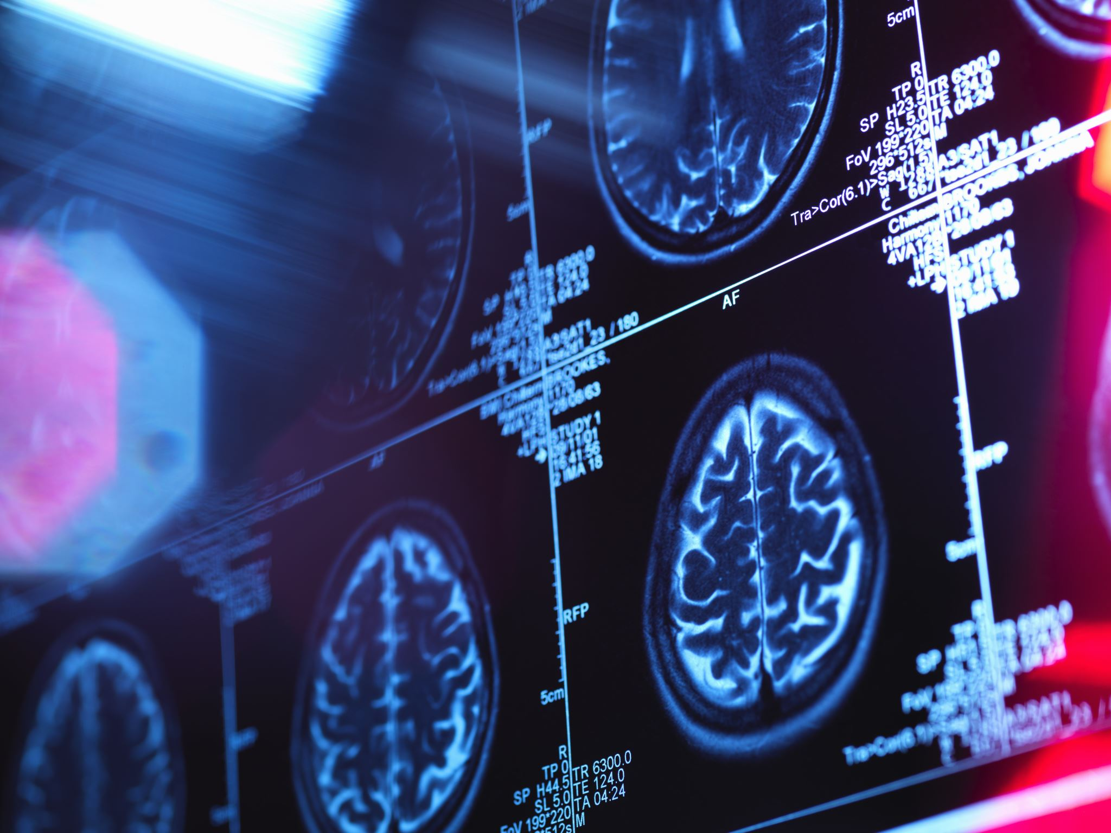
Past Approaches
AI has been used for diagnostic imaging, genetic testing, and electrodiagnosis.
Techniques like support vector machines (SVM) and neural networks have been popular.

Slide 4
Present Approaches
AI is currently applied in early detection and diagnosis, treatment, and outcome prediction.
Deep learning and natural language processing (NLP) are widely used.

Slide 5
Future Approaches
AI aims to assist in clinical decision making and real-time health risk alerts.
Systems like IBM Watson are pioneering in this field.

Slide 6

Opportunities and Threats
Opportunities:
• Improved patient outcomes because of personalized medicine and less human error
• Personalized AI “doctor” that uses neural networks to study your personal health trends
• Potential for a personal doctor due to AI
Threats:
• Privacy concerns (patient data protection)
• Risk of Large Language Models being “jail-broken”
• Bias in NLP models, especially in Large Language Models

Slide 7

Strategic Options for Cotiviti
1. Invest in Research: Cotiviti can fund research on multimodal NLT, focusing on integrating NLP, OCR, and computer vision for health care applications.
2. Ask the people: Success lies in developing technology that people want, not just the newest technology.

Slide 8
Conclusion
Clinical natural language technology (NLT) integrates various AI technologies such as NLP and computer vision to transform patient care and decision-making in healthcare.

